Slide 1

ROAD ACCIDENTS IN USA
Mini Project 1
July 2021
Anthony Nnamani

Slide 2
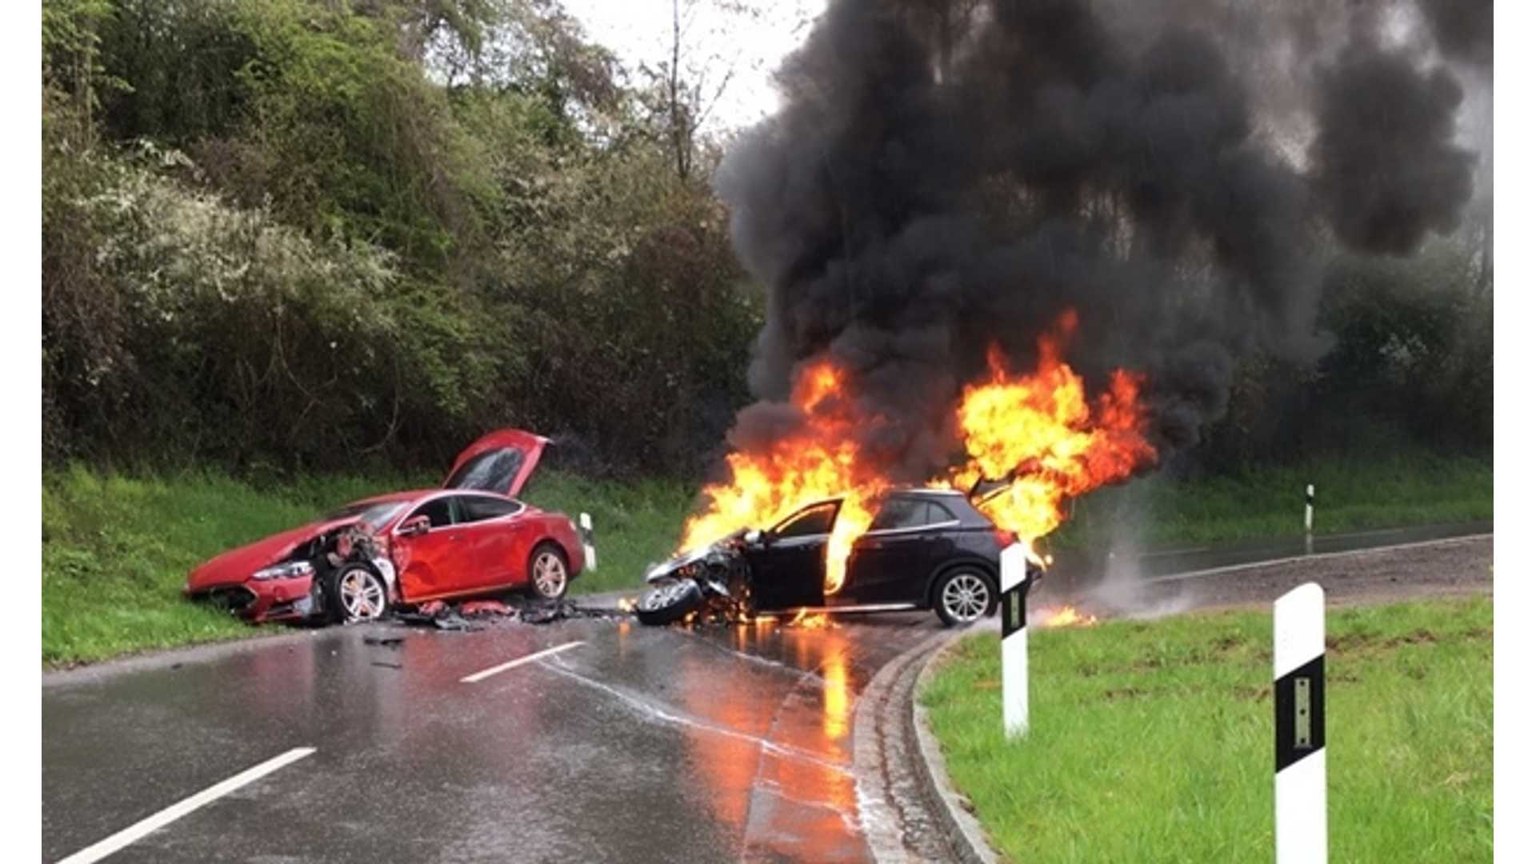
Business QUESTION
Does weather condition such as temperature, relative humidity has impact on road accident?

Slide 3
IMPORTANCE OF THIS STUDY
About 1.35 million people die on road accident globally every year (According WHO data).
Road accident cost the global economy about 518 billion dollars(USD) annually.
According to National Highway Traffic Safety Administration (NHTSA)
Accidents happen in US every 60seconds
About 6.76 millions of accidents reported to police in 2019
About 36,096 people killed and about 2.71 millions injured.
Understanding the effect of weather condition on road accident will help the authority to advise the general public appropriately when there is extreme weather condition.

Slide 4
Data overview
Publicly Available Data from Kaggle website.
About 1048575 observations of road accidents that happened in the US from 2016 to 2020.
Two separate 100 samples selected at random from the data with the temperature above and below average temperature for hypothesis testing.
And another set of 100 samples selected at random from observation with relative humidity above and below average relative humidity as well for humidity hypothesis testing.

Slide 5
Pipeline
Define
  Data acquisition
  Business questions
  Strategy
Data Cleaning
Exploring data
Cleaning and transforming data
Visualization
Plotting interested variables from the data to get insight
Hypothesize
Conducting hypothesis testing on the dataset
Further Studies
Regression Analysis
Machine Learning
Deep Learning

Slide 6
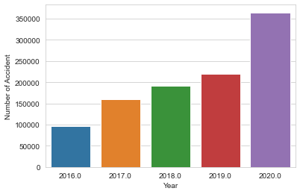
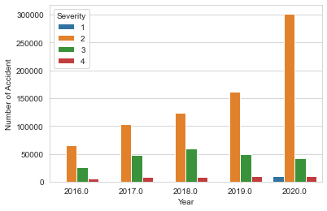
Road Accidents in us by year
Number of Accidents per year
Accident per year grouped by Severity

Slide 7
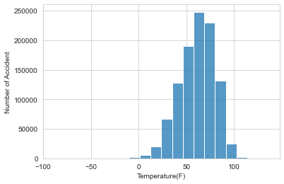
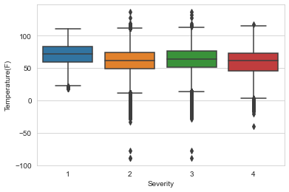
Accident according to temperature
Number Of Accidents Under Some Temperature Range
Accident per Temperature grouped by Severity

Slide 8
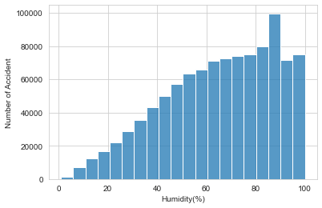
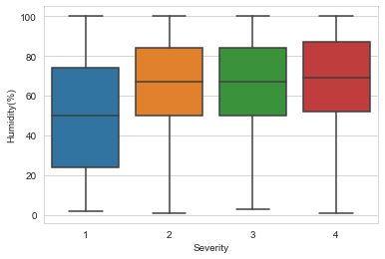
ACCIDENT BY RELATIVE HUMIDITY
Accident per humidity grouped by severity
Number of accident per humidity

Slide 9



HYPOTHESIS TESTING
1
H0: Change in average temperature has impact on road accident in USA
H1: Change in average temperature does not have impact on road accident in USA.
2
H0: Change in relative humidity has effect on road accident in USA
H1: Change in relative humidity does not affect road accident in USA
Alpha = 0.05 for both test

Slide 10
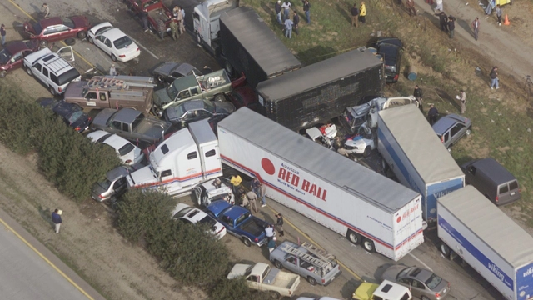
RESULT OF HYPOTHESIS
TEMPERATURE
US Average annual temperature = 52.7⁰F
Average temperature of dataset = 60.98⁰F
t = 0.578
p = 0.563
I fail to reject the null hypothesis; change in average temperature has impact on road accidents in US

Slide 11

RESULT OF HYPOTHESIS
HUMIDITY
US Average annual relative humidity = 67.048%
Average relative humidity of dataset = 65.387%
t2 = -0.781
p2 = 0.435
I fail to reject the null hypothesis; change in average relative humidity does have effect on road accidents in US

Slide 12
SUMMARY
Road accident is a very serious issue around the world
Tens of thousands of lives are lost yearly on road accident and billions of dollars also lost because of road accident
About 6.76millions of road accidents were recorded in US in 2019
About 36,096 killed and 2.71 millions injured
So many factors such as socio-economic and environmental factors have impact on the road accidents
In this study, effect of temperature and relative humidity on road accident in US were tested using hypothesis and the result showed that change in average temperature can cause accident also does change in average relative humidity

Slide 13
LIMITATION AND FURTHER STUDIES
The data was from USA alone so can not be generalized on a global scale.
This analysis was on two features(Temperature and Relative humidity) only using hypothesis
Other features can be included in the analysis as well as using other analytic technique such as regression, machine learning and deep learning in order to gain more insight from the dataset

Slide 14

THANK YOU
STAY SAFE

